Slide 1
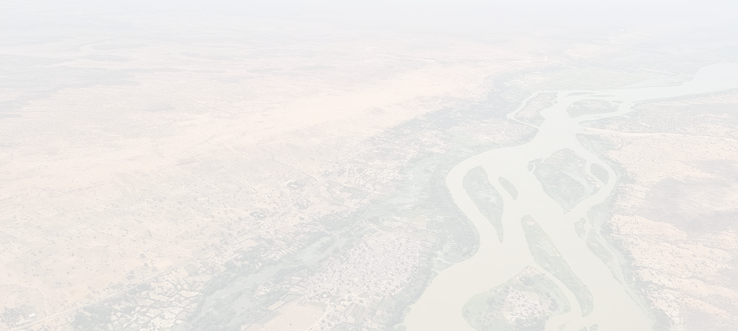


Sahel X - Okegaz
A data-driven solution to restore degraded lands & empower decision-making in the Sahel.
Notes:
Welcome to Ijo

Slide 2
Problem: The Sahel is in Crisis
Climate Change
Environmental Factors
Land Degradation
Water Scarcity
Environmental & Socio-Economic Crisis
Population Growth & Urbanization
Socio-Economic Factors
Resource Conflicts
Uncoordinated Land Management
Governance &
Data Challenges
Data Silos & Limited Access
Weak Early Warning & Forecasting Systems
Source: G20 Global Land Initiative
01
Notes:
Did you know that 71% of all emitted greenhouse gas can be traced back to only 100 companies?
Large companies have a big role and responsibility in fighting back climate change.

Slide 3
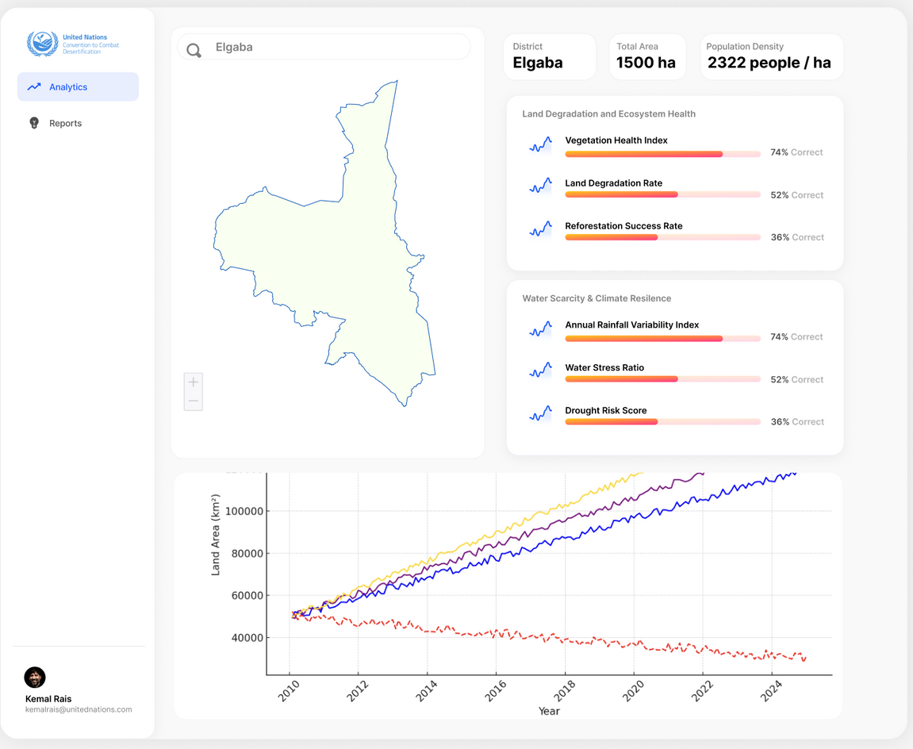
Our Solution
02

